Slide 1
ONLINE NEWS Popularity
Anqi Gu, Yiwei Li, Hongyu Liao, Han Zhang, Evelyn Zhou

Slide 2
CONTENTS
Background and objective
Data
EDA
Feature Engineering

Slide 3
Background
Online news popularity has increased with the rise of digital platforms, where articles rapidly gain traction through shares, likes, and views. This phenomenon highlights the dynamic nature of news consumption in the digital age, driven by audience behavior and social media trends.
01

Slide 4
Objective
Predict online news popularity by identifying key features influencing shareability, optimizing content strategies, and exploring automated model deployment for real-world applications.

Slide 5
02
Data
Overview of Dataset Structure

Slide 6
Dataset characteristics
Type: Multivariate
Subject Area: Business
Features: 58
Target Variable: shares (number of times an article was shared)
No Missing Values

Slide 7
EDA
02
Key Findings and Insights

Slide 8
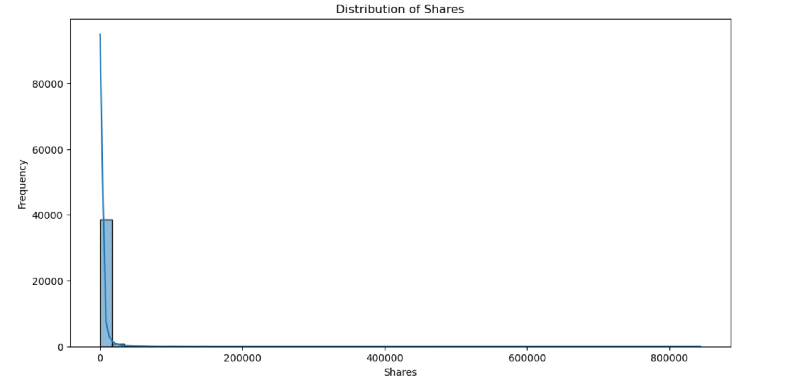
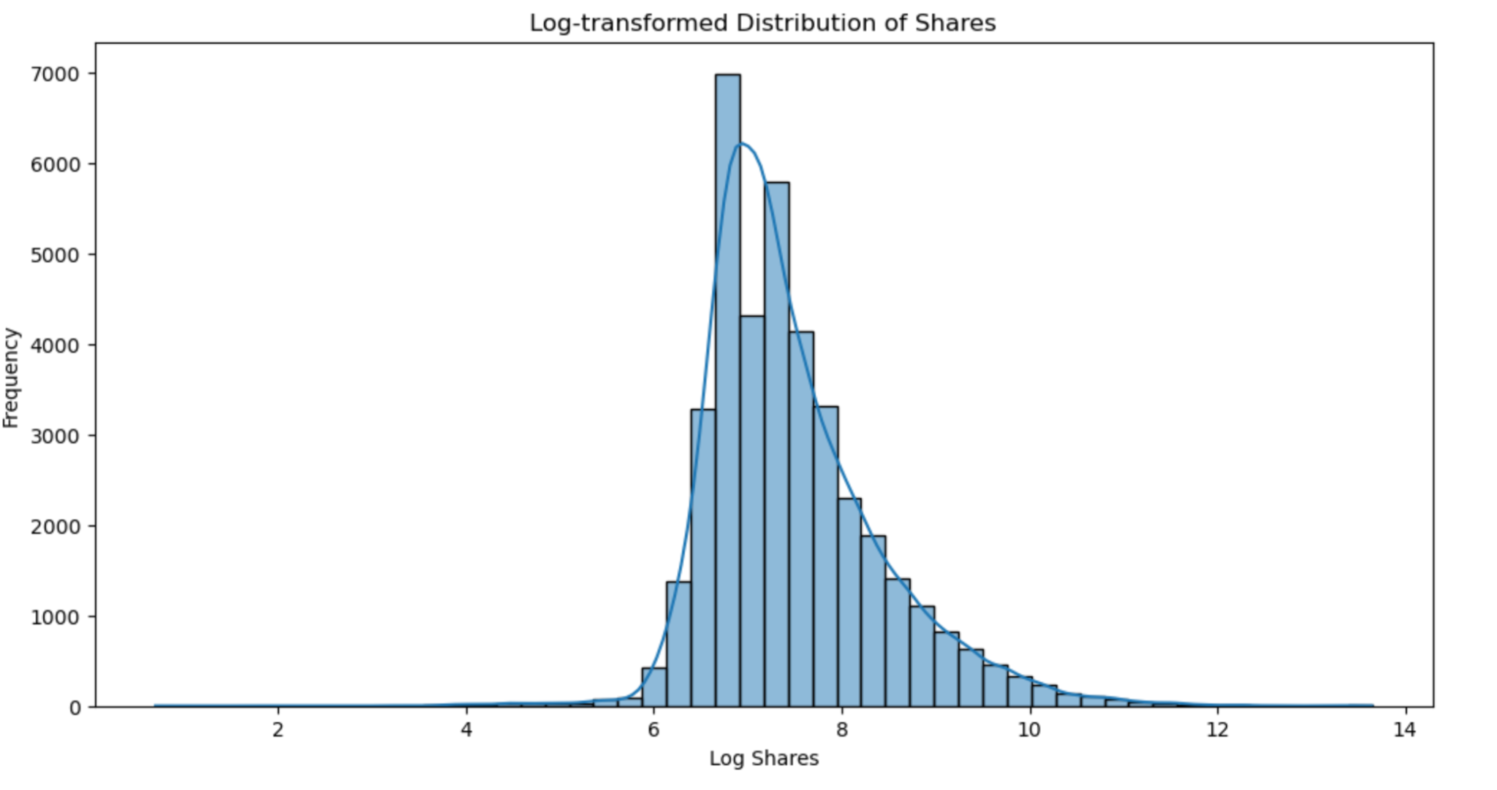
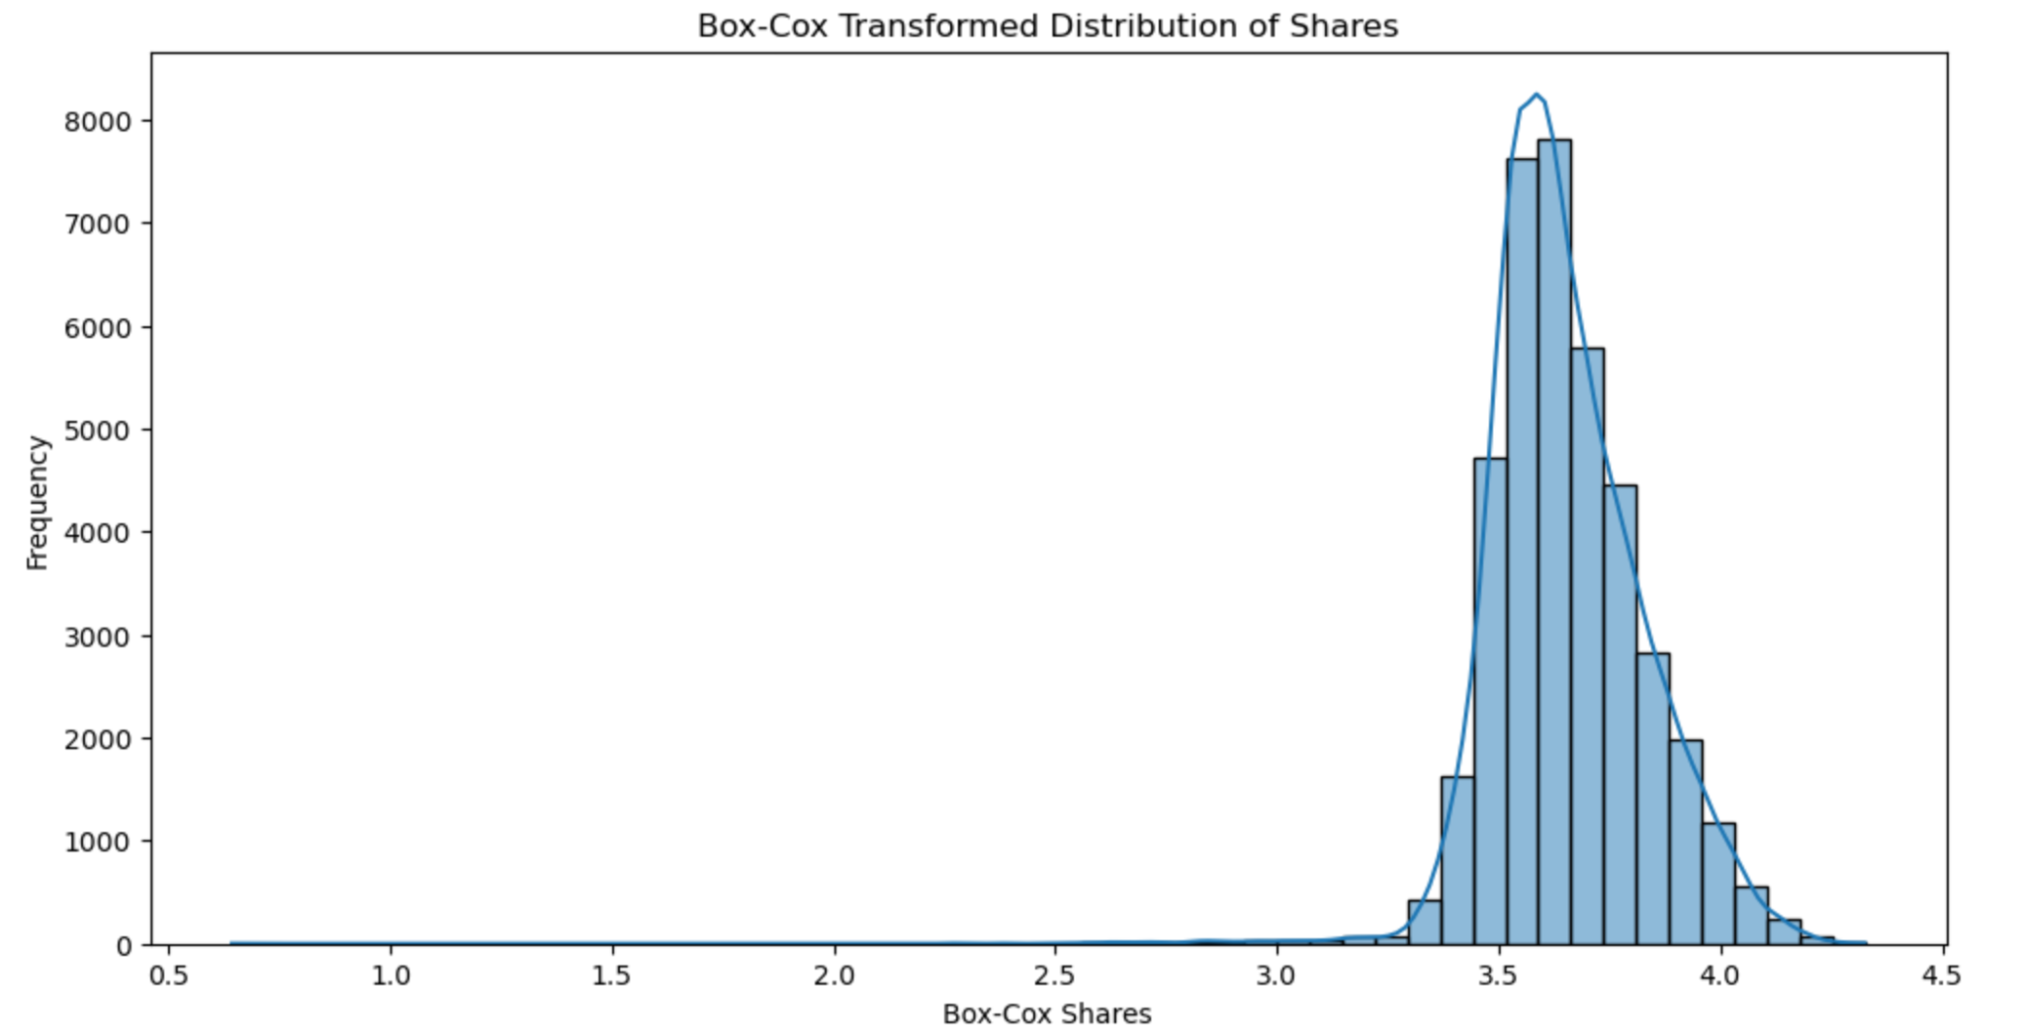
Shares Distribution
(Original and Transformed)
Observation: Shares are heavily skewed towards low counts.
Action: Applied log and Box-Cox transformations.
Result: Normalized distributions, suitable for modeling.

Slide 9
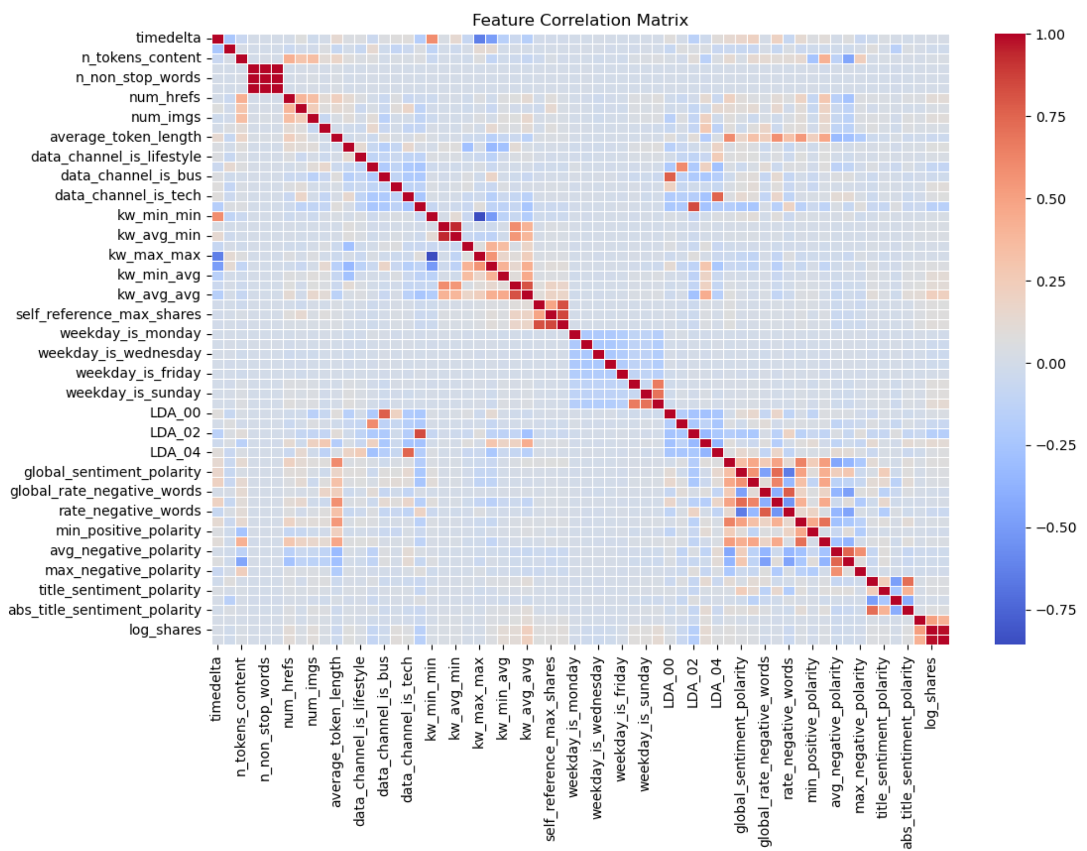
Correlation Insights
High Correlation:
log_shares and boxcox_shares with shares
Positive keywords (kw_avg_avg) show minor impact.
Low Correlation:
Negative word rates (rate_negative_words).

Slide 10
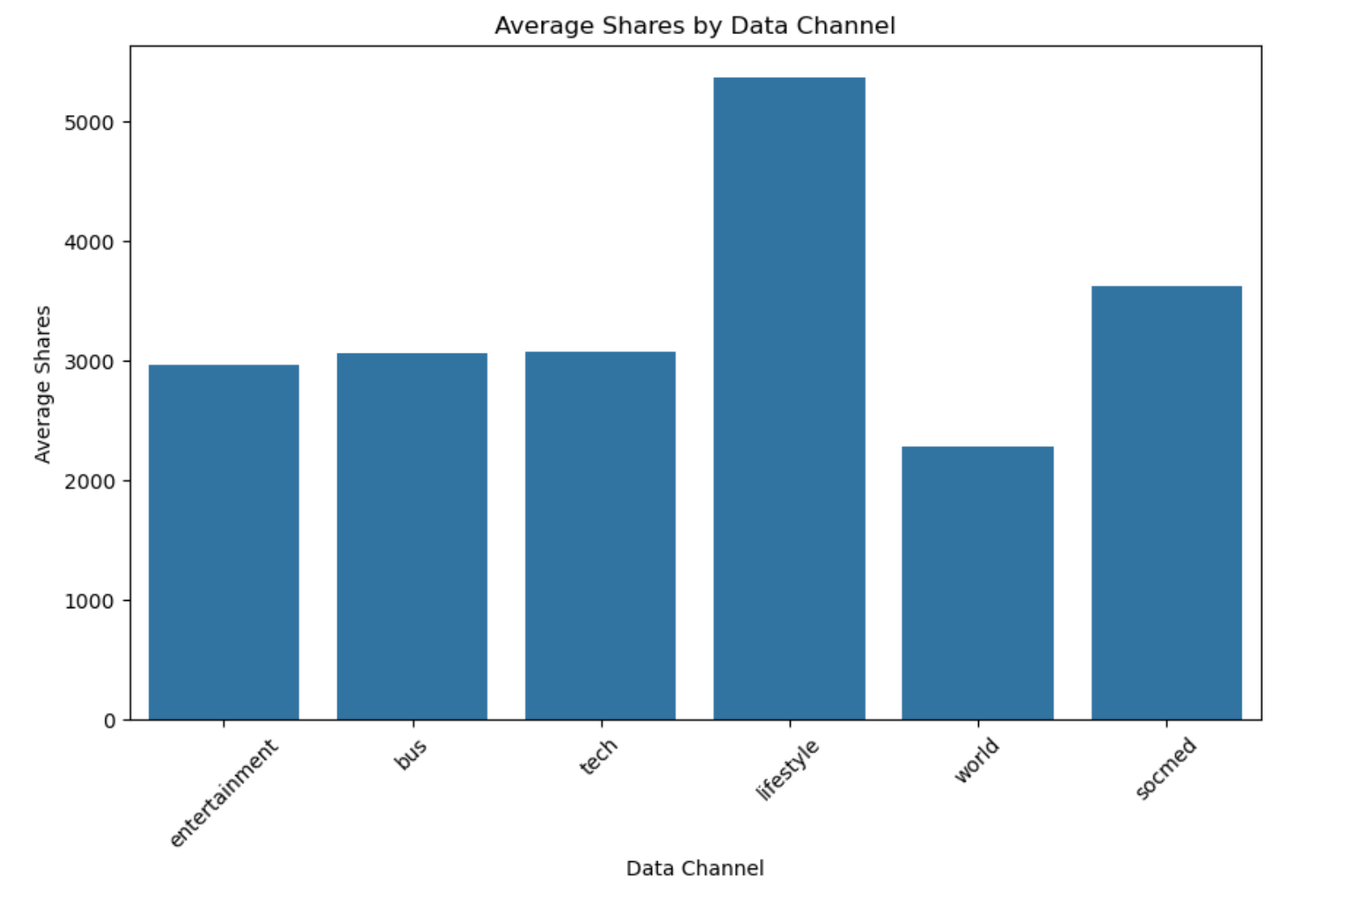
Data Channels Analysis
Insight: Lifestyle and Social Media channels perform best.
Average Shares:
Lifestyle: Highest engagement.
World: Lower engagement.

Slide 11
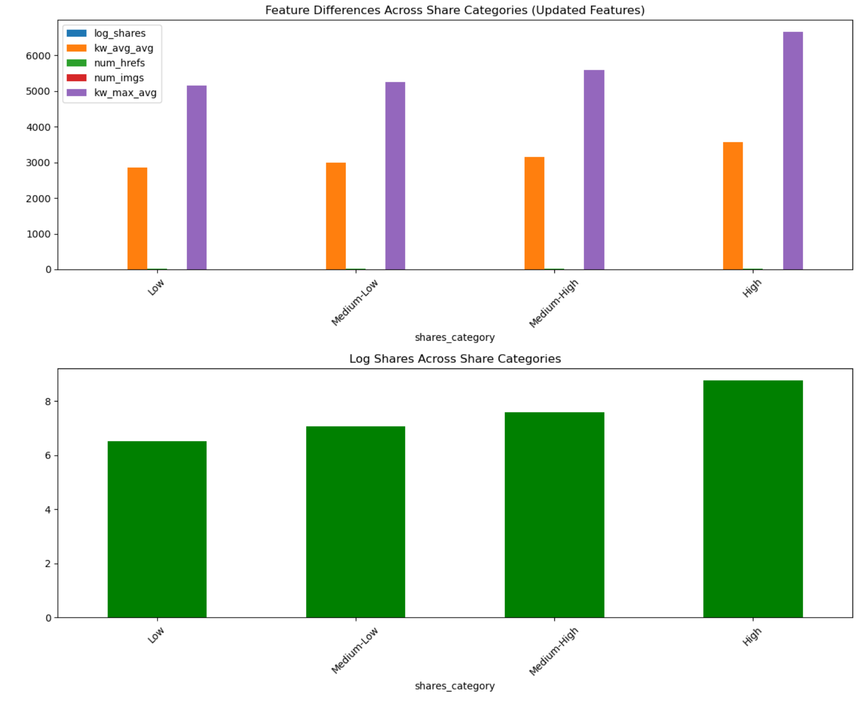
Feature Importance by Share Levels
Categories: Low, Medium-Low, Medium-High, High shares.
Key Insights:
log-transformed shares increases consistently across share levels.
kw_max_avg is highest in high-share articles.
num_hrefs and num_imgs remain steady but low contributors.

Slide 12
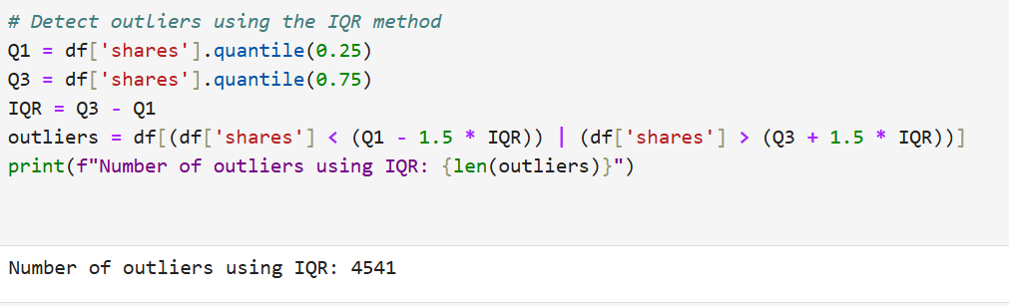
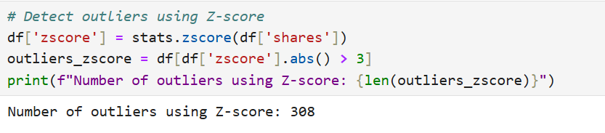
Outlier Detection
Methods: IQR (4541) and Z-score (308).
Finding: Viral articles skew shares heavily.
Action: Marked outliers for further analysis.

Slide 13
03
Feature Engineering
Transformations and Techniques for Enhanced Predictive Power

Slide 14
Boolean Features Conversion
Observation:
Categorical features like is_weekend and data_channel_is_ were converted into boolean types for easier analysis.
Result:
Enhanced interpretability and consistency for machine learning algorithms.

Slide 15
Skewness Correction
Observation:
Many features had high skewness, such as n_tokens_content (2.95), num_imgs (3.95), and num_hrefs (4.01).
Transformation methods like square root and Yeo-Johnson significantly reduced skewness.
Advantages：
Improved Model Performance
Reduced Impact of Outliers
USERNAME
PASSWORD
LOGIN

Slide 16
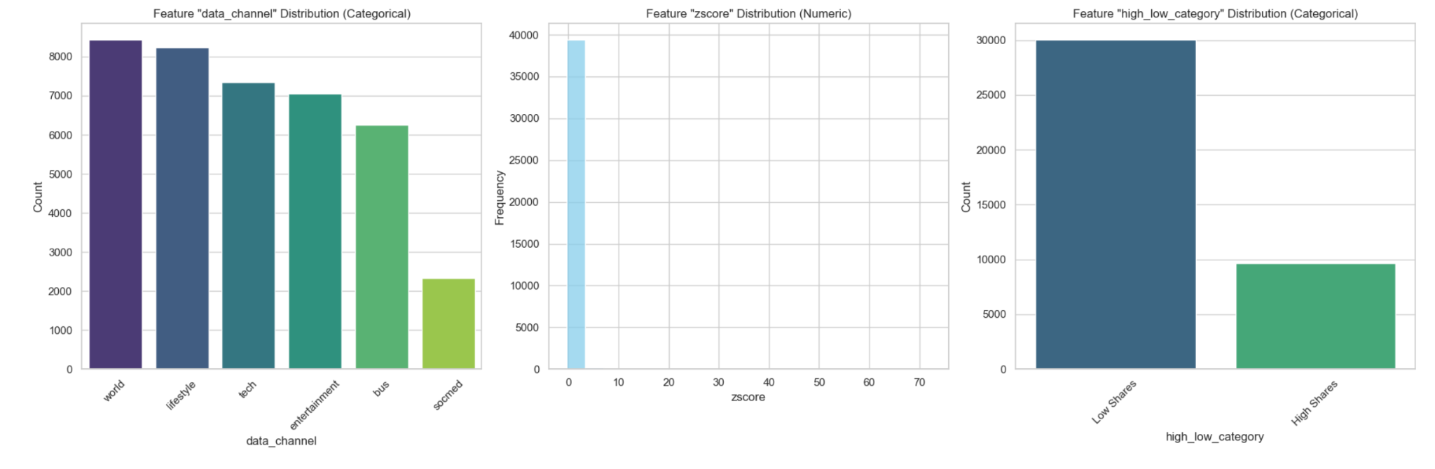

Slide 17
Feature Analysis Insights
Data Channel Distribution
Observation: "World" dominate; "Socmed" is least frequent. Insight: Opportunity to explore engagement strategies for underrepresented channels.
2. Z-Score Distribution
Observation: Most data points are near zero, indicating minimal outliers. Insight: Feature scaling effectively reduces the influence of extreme values.
3. High vs. Low Shares
Observation: Most articles fall into the "low shares" category. Insight: Highlights the need to identify drivers of high engagement.

